Slide 1
Deep Neural Network

Slide 2
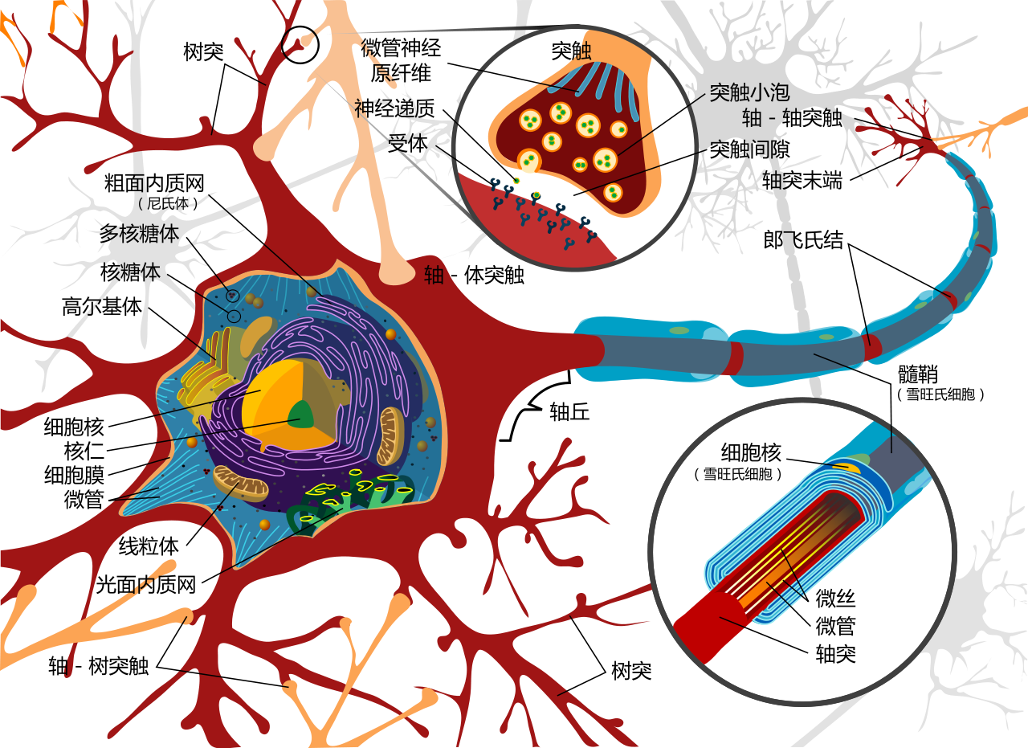
神經細胞
單個神經細胞可被視為一種只有兩種狀態的機器
啟動時為TRUE
未啟動為FALSE
狀態取決於來自其它神經細胞的信號量
突觸的強度(抑制或增強)
有一個門檻值
信號量超過門檻值則啟動
未超過則不啟動
啟動後，則把這個值再傳給下一個神經細胞
Notes:
\begin{bmatrix}
a_{1} & b_{1} \\
a_{2} & b_{2} \\
a_{3} & b_{3} \\
\hdotsfor{2} \\
a_{n} & b_{n}
\end{bmatrix}
\begin{bmatrix}
w_1 \\ w_2 \\
\end{bmatrix}
=
\begin{bmatrix}
y_{1} \\
y_{2} \\
y_{3} \\
\hdotsfor{1} \\
y_{n}
\end{bmatrix}

Slide 3
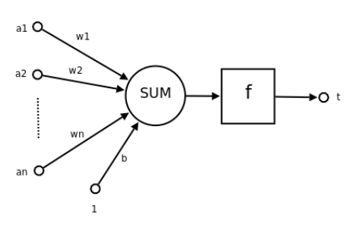
模擬神經細胞
神經元->單個神經細胞
a1-an (輸入值)->來自其它神經元的信號量
w1-wn (權重)->突觸的強度
b ->門檻值
f->傳遞函數
t->信號量輸出
Notes:
\begin{bmatrix}
a_{1} & b_{1} \\
a_{2} & b_{2} \\
a_{3} & b_{3} \\
\hdotsfor{2} \\
a_{n} & b_{n}
\end{bmatrix}
\begin{bmatrix}
w_1 \\ w_2 \\
\end{bmatrix}
=
\begin{bmatrix}
y_{1} \\
y_{2} \\
y_{3} \\
\hdotsfor{1} \\
y_{n}
\end{bmatrix}

Slide 4
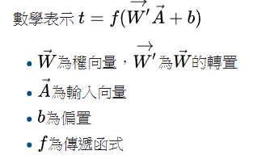
模擬神經細胞
Notes:
\begin{bmatrix}
a_{1} & b_{1} \\
a_{2} & b_{2} \\
a_{3} & b_{3} \\
\hdotsfor{2} \\
a_{n} & b_{n}
\end{bmatrix}
\begin{bmatrix}
w_1 \\ w_2 \\
\end{bmatrix}
=
\begin{bmatrix}
y_{1} \\
y_{2} \\
y_{3} \\
\hdotsfor{1} \\
y_{n}
\end{bmatrix}

Slide 5
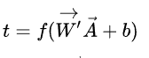
神經元(模擬神經細胞)
神經元的功能是求得輸入向量與權向量的內積後，經一個非線性傳遞函式得到一個純量結果
Notes:
\begin{bmatrix}
a_{1} & b_{1} \\
a_{2} & b_{2} \\
a_{3} & b_{3} \\
\hdotsfor{2} \\
a_{n} & b_{n}
\end{bmatrix}
\begin{bmatrix}
w_1 \\ w_2 \\
\end{bmatrix}
=
\begin{bmatrix}
y_{1} \\
y_{2} \\
y_{3} \\
\hdotsfor{1} \\
y_{n}
\end{bmatrix}

Slide 6
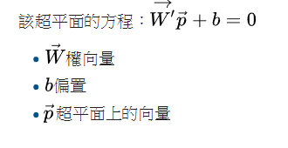
神經元的作用
把一個n維向量空間用一個超平面分割成兩部分（稱之為判斷邊界）給定一個輸入向量，神經元可以判斷出這個向量位於超平面的哪一邊
Notes:
\begin{bmatrix}
a_{1} & b_{1} \\
a_{2} & b_{2} \\
a_{3} & b_{3} \\
\hdotsfor{2} \\
a_{n} & b_{n}
\end{bmatrix}
\begin{bmatrix}
w_1 \\ w_2 \\
\end{bmatrix}
=
\begin{bmatrix}
y_{1} \\
y_{2} \\
y_{3} \\
\hdotsfor{1} \\
y_{n}
\end{bmatrix}

Slide 7
Activation Function (啟動/激活/傳遞函數)
把輸出結果值轉換到一個期望的範圍值
通常表示這個神經元啟動的「可能性」
感知器的f為binary(0或1)
最常用的是s型(sigmoid，介於0和1)
不同的啟動函數造就不同性質的神經元
Notes:
\begin{bmatrix}
a_{1} & b_{1} \\
a_{2} & b_{2} \\
a_{3} & b_{3} \\
\hdotsfor{2} \\
a_{n} & b_{n}
\end{bmatrix}
\begin{bmatrix}
w_1 \\ w_2 \\
\end{bmatrix}
=
\begin{bmatrix}
y_{1} \\
y_{2} \\
y_{3} \\
\hdotsfor{1} \\
y_{n}
\end{bmatrix}

Slide 8
Activation Function的期望特色
非線性
為一範圍值
連續可微分
單一性
Notes:
\begin{bmatrix}
a_{1} & b_{1} \\
a_{2} & b_{2} \\
a_{3} & b_{3} \\
\hdotsfor{2} \\
a_{n} & b_{n}
\end{bmatrix}
\begin{bmatrix}
w_1 \\ w_2 \\
\end{bmatrix}
=
\begin{bmatrix}
y_{1} \\
y_{2} \\
y_{3} \\
\hdotsfor{1} \\
y_{n}
\end{bmatrix}

Slide 9
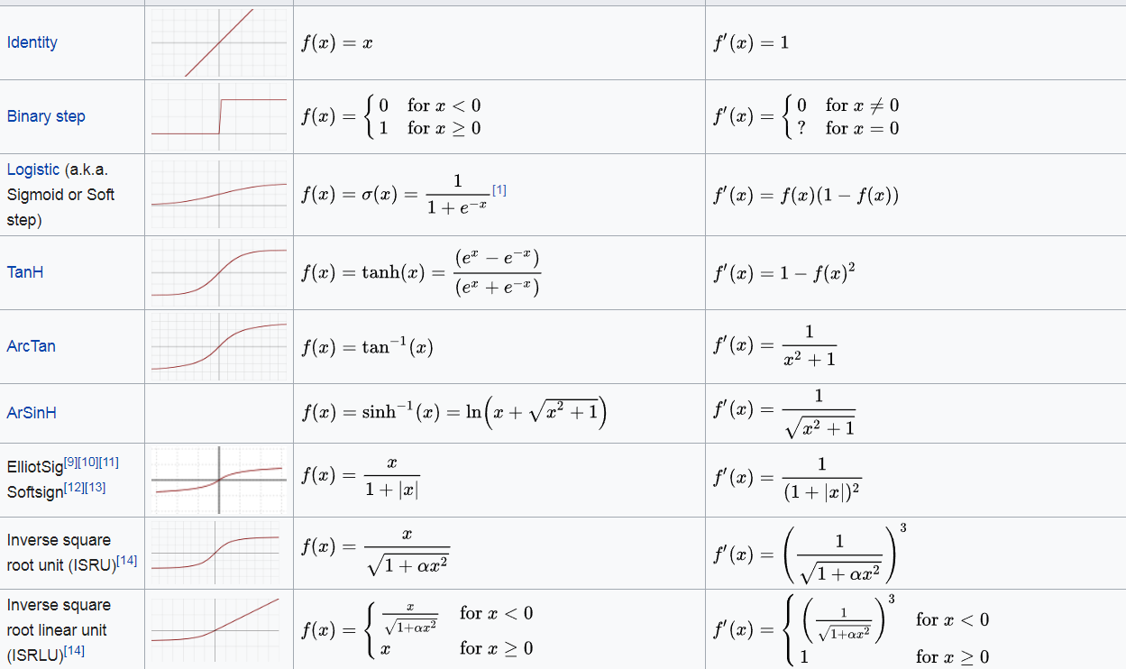

Slide 10
What is neural network?

Slide 11
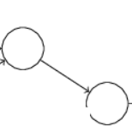
類神經網路(Neural Network)
由多個神經元，互相連接組成的網路
Notes:
\begin{bmatrix}
a_{1} & b_{1} \\
a_{2} & b_{2} \\
a_{3} & b_{3} \\
\hdotsfor{2} \\
a_{n} & b_{n}
\end{bmatrix}
\begin{bmatrix}
w_1 \\ w_2 \\
\end{bmatrix}
=
\begin{bmatrix}
y_{1} \\
y_{2} \\
y_{3} \\
\hdotsfor{1} \\
y_{n}
\end{bmatrix}

Slide 12
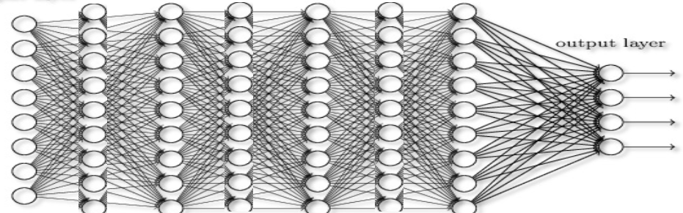
類神經網路(Neural Network)
或是
Notes:
\begin{bmatrix}
a_{1} & b_{1} \\
a_{2} & b_{2} \\
a_{3} & b_{3} \\
\hdotsfor{2} \\
a_{n} & b_{n}
\end{bmatrix}
\begin{bmatrix}
w_1 \\ w_2 \\
\end{bmatrix}
=
\begin{bmatrix}
y_{1} \\
y_{2} \\
y_{3} \\
\hdotsfor{1} \\
y_{n}
\end{bmatrix}

Slide 13
Neural network
又稱Artificial Neural Network(ANN)，類神經網路，人工神經網路
模仿生物大腦結構
數學或計算模型
對函數取估計或近似值
由大量神經元互相連接組成
用外部的資料改變內部結構
為一自適應系統，即具備學習能力
近幾年已放棄模擬生物學
使用統計和訊號處理方法
Notes:
\begin{bmatrix}
a_{1} & b_{1} \\
a_{2} & b_{2} \\
a_{3} & b_{3} \\
\hdotsfor{2} \\
a_{n} & b_{n}
\end{bmatrix}
\begin{bmatrix}
w_1 \\ w_2 \\
\end{bmatrix}
=
\begin{bmatrix}
y_{1} \\
y_{2} \\
y_{3} \\
\hdotsfor{1} \\
y_{n}
\end{bmatrix}

Slide 14
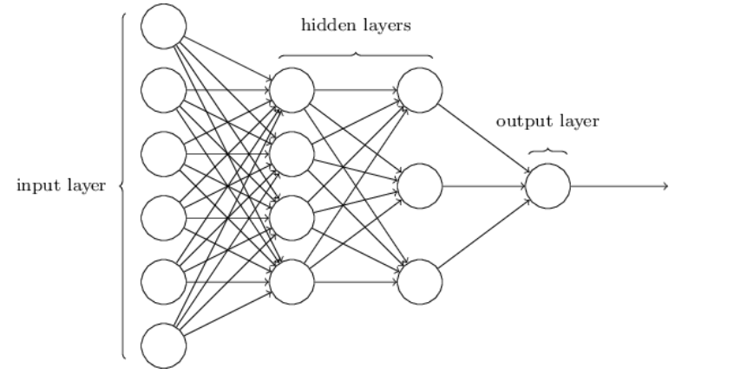
Structure of a deep nn or feedforward neural network

Slide 15
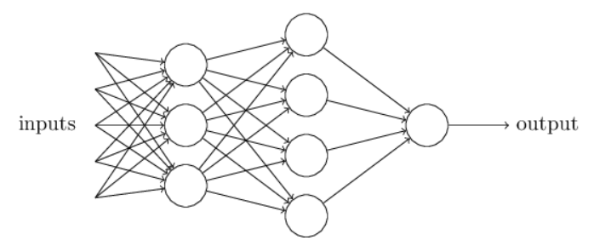
多重感知器Multi-layer Perceptrons (MLP)
Notes:
\begin{bmatrix}
a_{1} & b_{1} \\
a_{2} & b_{2} \\
a_{3} & b_{3} \\
\hdotsfor{2} \\
a_{n} & b_{n}
\end{bmatrix}
\begin{bmatrix}
w_1 \\ w_2 \\
\end{bmatrix}
=
\begin{bmatrix}
y_{1} \\
y_{2} \\
y_{3} \\
\hdotsfor{1} \\
y_{n}
\end{bmatrix}

Slide 16
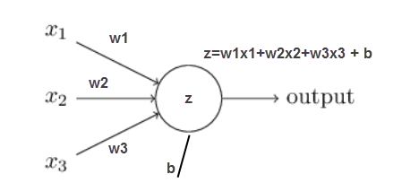
For every neuron

Slide 17
感知器(Perceptrons)
輸出值為0或1的神經元
由Frank Rosenblatt在1950年代發明
輸入值也是0或1(binary)
首度引入了權重(weights)的概念
首度引入了門檻值的概念
Notes:
\begin{bmatrix}
a_{1} & b_{1} \\
a_{2} & b_{2} \\
a_{3} & b_{3} \\
\hdotsfor{2} \\
a_{n} & b_{n}
\end{bmatrix}
\begin{bmatrix}
w_1 \\ w_2 \\
\end{bmatrix}
=
\begin{bmatrix}
y_{1} \\
y_{2} \\
y_{3} \\
\hdotsfor{1} \\
y_{n}
\end{bmatrix}

Slide 18
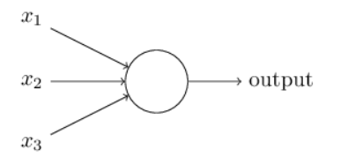
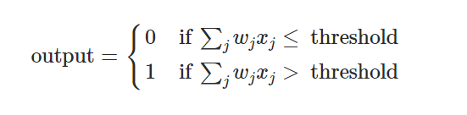
感知器(Perceptrons)
Notes:
\begin{bmatrix}
a_{1} & b_{1} \\
a_{2} & b_{2} \\
a_{3} & b_{3} \\
\hdotsfor{2} \\
a_{n} & b_{n}
\end{bmatrix}
\begin{bmatrix}
w_1 \\ w_2 \\
\end{bmatrix}
=
\begin{bmatrix}
y_{1} \\
y_{2} \\
y_{3} \\
\hdotsfor{1} \\
y_{n}
\end{bmatrix}

Slide 19
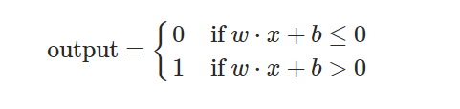
感知器(Perceptrons)
Notes:
\begin{bmatrix}
a_{1} & b_{1} \\
a_{2} & b_{2} \\
a_{3} & b_{3} \\
\hdotsfor{2} \\
a_{n} & b_{n}
\end{bmatrix}
\begin{bmatrix}
w_1 \\ w_2 \\
\end{bmatrix}
=
\begin{bmatrix}
y_{1} \\
y_{2} \\
y_{3} \\
\hdotsfor{1} \\
y_{n}
\end{bmatrix}

Slide 20
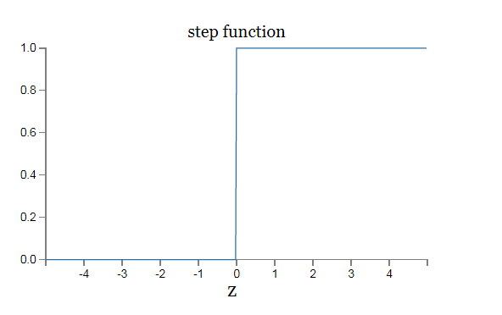
感知器(Perceptrons)

Slide 21
感知器的問題
無法處理互斥及迴路
電腦無運算能力處理大型神經網路
Notes:
\begin{bmatrix}
a_{1} & b_{1} \\
a_{2} & b_{2} \\
a_{3} & b_{3} \\
\hdotsfor{2} \\
a_{n} & b_{n}
\end{bmatrix}
\begin{bmatrix}
w_1 \\ w_2 \\
\end{bmatrix}
=
\begin{bmatrix}
y_{1} \\
y_{2} \\
y_{3} \\
\hdotsfor{1} \\
y_{n}
\end{bmatrix}

Slide 22
週六的五月天演唱會
天氣好不好？(x1)
女友或男友陪不陪？(x2)
是不是在小巨蛋(才有捷運坐)？(x3)
Notes:
\begin{bmatrix}
a_{1} & b_{1} \\
a_{2} & b_{2} \\
a_{3} & b_{3} \\
\hdotsfor{2} \\
a_{n} & b_{n}
\end{bmatrix}
\begin{bmatrix}
w_1 \\ w_2 \\
\end{bmatrix}
=
\begin{bmatrix}
y_{1} \\
y_{2} \\
y_{3} \\
\hdotsfor{1} \\
y_{n}
\end{bmatrix}

Slide 23
週六的五月天演唱會
天氣好不好？(x1)
女友或男友陪不陪？(x2)
是不是在小巨蛋(才有捷運坐)？(x3)
天氣好壞都可以，反正室內(w1)
一定要人陪(w2)
最好有捷運到，我沒車(w3)
Notes:
\begin{bmatrix}
a_{1} & b_{1} \\
a_{2} & b_{2} \\
a_{3} & b_{3} \\
\hdotsfor{2} \\
a_{n} & b_{n}
\end{bmatrix}
\begin{bmatrix}
w_1 \\ w_2 \\
\end{bmatrix}
=
\begin{bmatrix}
y_{1} \\
y_{2} \\
y_{3} \\
\hdotsfor{1} \\
y_{n}
\end{bmatrix}

Slide 24
週六的五月天演唱會
天氣好不好？(x1)
女友或男友陪不陪？(x2)
是不是在小巨蛋(才有捷運坐)？(x3)
天氣好壞都可以，反正室內(w1)
一定要人陪(w2)
最好有捷運到，我沒車(w3)
總分超過12分我才會去(b)
Notes:
\begin{bmatrix}
a_{1} & b_{1} \\
a_{2} & b_{2} \\
a_{3} & b_{3} \\
\hdotsfor{2} \\
a_{n} & b_{n}
\end{bmatrix}
\begin{bmatrix}
w_1 \\ w_2 \\
\end{bmatrix}
=
\begin{bmatrix}
y_{1} \\
y_{2} \\
y_{3} \\
\hdotsfor{1} \\
y_{n}
\end{bmatrix}

Slide 25
週六的五月天演唱會
晴天(x1=1)
女友或男友陪？(x2=3)
在小巨蛋(x3=2)
天氣好壞都可以，反正室內(w1=1)
一定要人陪(w2=3)
最好有捷運到，我沒車(w3=2)
總分超過10分我才會去(b)
x1w1+x2w2+x3w3 = 1+9+4 = 14 → 去！
Notes:
\begin{bmatrix}
a_{1} & b_{1} \\
a_{2} & b_{2} \\
a_{3} & b_{3} \\
\hdotsfor{2} \\
a_{n} & b_{n}
\end{bmatrix}
\begin{bmatrix}
w_1 \\ w_2 \\
\end{bmatrix}
=
\begin{bmatrix}
y_{1} \\
y_{2} \\
y_{3} \\
\hdotsfor{1} \\
y_{n}
\end{bmatrix}

Slide 26
週六的五月天演唱會
晴天(x1=1)
蔡依林陪我去(x2=10)
在殯儀館舉辦(x3=-10)
天氣好壞都可以，反正室內(w1=1)
一定要人陪(w2=3)
最好有捷運到，我沒車(w3=2)
總分超過10分我才會去(b)
x1w1+x2w2+x3w3 = 1+30+-20 = 11 → 去！
Notes:
\begin{bmatrix}
a_{1} & b_{1} \\
a_{2} & b_{2} \\
a_{3} & b_{3} \\
\hdotsfor{2} \\
a_{n} & b_{n}
\end{bmatrix}
\begin{bmatrix}
w_1 \\ w_2 \\
\end{bmatrix}
=
\begin{bmatrix}
y_{1} \\
y_{2} \\
y_{3} \\
\hdotsfor{1} \\
y_{n}
\end{bmatrix}

Slide 27
週六的五月天演唱會
晴天(x1=1)
兩個女友都說要陪我去(x2=-50)
在馬爾地夫免費機票招待我(x3=+30)
天氣好壞都可以，反正室內(w1=1)
一定要人陪(w2=3)
最好有捷運到，我沒車(w3=2)
總分超過10分我才會去(b)
x1w1+x2w2+x3w3 = 1-150+60 = -89 → 當然不能去！
Notes:
\begin{bmatrix}
a_{1} & b_{1} \\
a_{2} & b_{2} \\
a_{3} & b_{3} \\
\hdotsfor{2} \\
a_{n} & b_{n}
\end{bmatrix}
\begin{bmatrix}
w_1 \\ w_2 \\
\end{bmatrix}
=
\begin{bmatrix}
y_{1} \\
y_{2} \\
y_{3} \\
\hdotsfor{1} \\
y_{n}
\end{bmatrix}

Slide 28
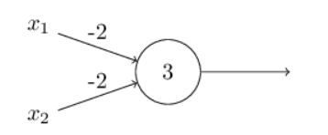
Use perceptrons doing logic gate NAND
x1=1
X2=1
Sum + b = -4 < 3 -> 0
Notes:
\begin{bmatrix}
a_{1} & b_{1} \\
a_{2} & b_{2} \\
a_{3} & b_{3} \\
\hdotsfor{2} \\
a_{n} & b_{n}
\end{bmatrix}
\begin{bmatrix}
w_1 \\ w_2 \\
\end{bmatrix}
=
\begin{bmatrix}
y_{1} \\
y_{2} \\
y_{3} \\
\hdotsfor{1} \\
y_{n}
\end{bmatrix}

Slide 29
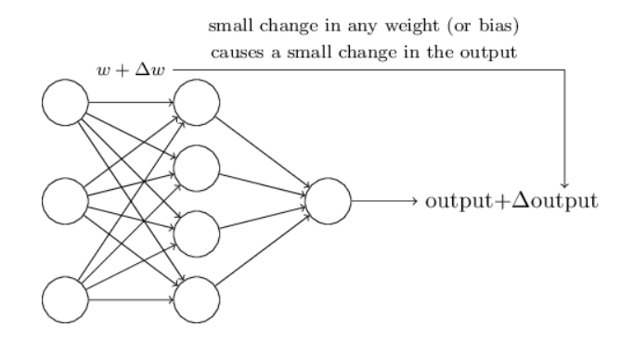
The meaning of weight/bias updates
Notes:
\begin{bmatrix}
a_{1} & b_{1} \\
a_{2} & b_{2} \\
a_{3} & b_{3} \\
\hdotsfor{2} \\
a_{n} & b_{n}
\end{bmatrix}
\begin{bmatrix}
w_1 \\ w_2 \\
\end{bmatrix}
=
\begin{bmatrix}
y_{1} \\
y_{2} \\
y_{3} \\
\hdotsfor{1} \\
y_{n}
\end{bmatrix}

Slide 30
只有0或1而無法微調的感知器
當微調w或b時，最後的輸出output會突然變成完全相反的結果，就算使用多個感知器組成的nn，也會輸出最後完全相反的結果，而無法達到學習的目的
Notes:
\begin{bmatrix}
a_{1} & b_{1} \\
a_{2} & b_{2} \\
a_{3} & b_{3} \\
\hdotsfor{2} \\
a_{n} & b_{n}
\end{bmatrix}
\begin{bmatrix}
w_1 \\ w_2 \\
\end{bmatrix}
=
\begin{bmatrix}
y_{1} \\
y_{2} \\
y_{3} \\
\hdotsfor{1} \\
y_{n}
\end{bmatrix}

Slide 31
Smooth it
What if we can output something in between?
Notes:
\begin{bmatrix}
a_{1} & b_{1} \\
a_{2} & b_{2} \\
a_{3} & b_{3} \\
\hdotsfor{2} \\
a_{n} & b_{n}
\end{bmatrix}
\begin{bmatrix}
w_1 \\ w_2 \\
\end{bmatrix}
=
\begin{bmatrix}
y_{1} \\
y_{2} \\
y_{3} \\
\hdotsfor{1} \\
y_{n}
\end{bmatrix}

Slide 32
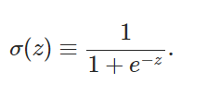
S型神經元(Sigmoid Neuron)
讓輸出值介於0或1之間
當w或b有微小改變時，output也是微小改變。
整個網路因此具備有學習能力
讓這個世界不要這麼絕對，有點機率的味道
Notes:
\begin{bmatrix}
a_{1} & b_{1} \\
a_{2} & b_{2} \\
a_{3} & b_{3} \\
\hdotsfor{2} \\
a_{n} & b_{n}
\end{bmatrix}
\begin{bmatrix}
w_1 \\ w_2 \\
\end{bmatrix}
=
\begin{bmatrix}
y_{1} \\
y_{2} \\
y_{3} \\
\hdotsfor{1} \\
y_{n}
\end{bmatrix}

Slide 33
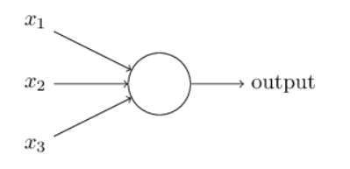
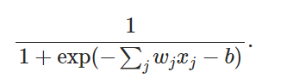
S型神經元(Sigmoid Neuron)
Notes:
\begin{bmatrix}
a_{1} & b_{1} \\
a_{2} & b_{2} \\
a_{3} & b_{3} \\
\hdotsfor{2} \\
a_{n} & b_{n}
\end{bmatrix}
\begin{bmatrix}
w_1 \\ w_2 \\
\end{bmatrix}
=
\begin{bmatrix}
y_{1} \\
y_{2} \\
y_{3} \\
\hdotsfor{1} \\
y_{n}
\end{bmatrix}

Slide 34
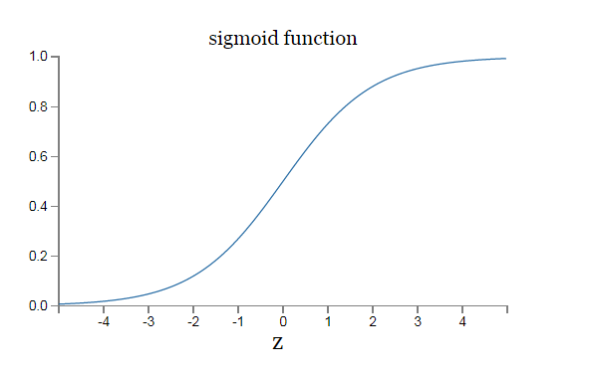
S型神經元(Sigmoid Neuron)
Notes:
\begin{bmatrix}
a_{1} & b_{1} \\
a_{2} & b_{2} \\
a_{3} & b_{3} \\
\hdotsfor{2} \\
a_{n} & b_{n}
\end{bmatrix}
\begin{bmatrix}
w_1 \\ w_2 \\
\end{bmatrix}
=
\begin{bmatrix}
y_{1} \\
y_{2} \\
y_{3} \\
\hdotsfor{1} \\
y_{n}
\end{bmatrix}

Slide 35
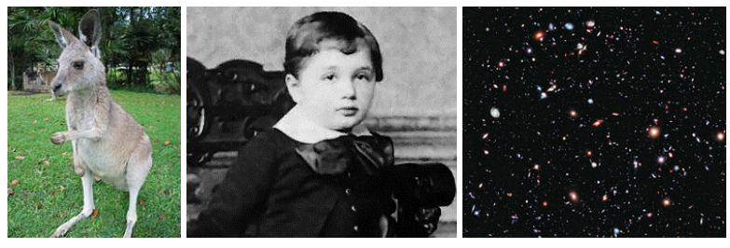
Toward Deep Learning Face recognization
Notes:
\begin{bmatrix}
a_{1} & b_{1} \\
a_{2} & b_{2} \\
a_{3} & b_{3} \\
\hdotsfor{2} \\
a_{n} & b_{n}
\end{bmatrix}
\begin{bmatrix}
w_1 \\ w_2 \\
\end{bmatrix}
=
\begin{bmatrix}
y_{1} \\
y_{2} \\
y_{3} \\
\hdotsfor{1} \\
y_{n}
\end{bmatrix}

Slide 36
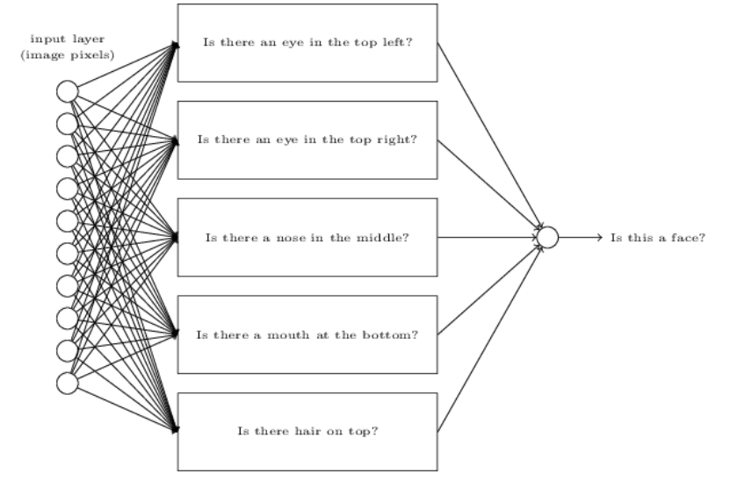
Toward Deep Learning Face recognization
Notes:
\begin{bmatrix}
a_{1} & b_{1} \\
a_{2} & b_{2} \\
a_{3} & b_{3} \\
\hdotsfor{2} \\
a_{n} & b_{n}
\end{bmatrix}
\begin{bmatrix}
w_1 \\ w_2 \\
\end{bmatrix}
=
\begin{bmatrix}
y_{1} \\
y_{2} \\
y_{3} \\
\hdotsfor{1} \\
y_{n}
\end{bmatrix}

Slide 37
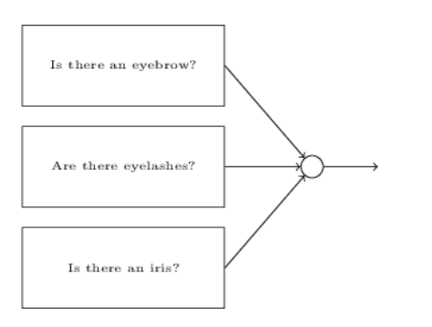
Toward Deep Learning Face recognization
Notes:
\begin{bmatrix}
a_{1} & b_{1} \\
a_{2} & b_{2} \\
a_{3} & b_{3} \\
\hdotsfor{2} \\
a_{n} & b_{n}
\end{bmatrix}
\begin{bmatrix}
w_1 \\ w_2 \\
\end{bmatrix}
=
\begin{bmatrix}
y_{1} \\
y_{2} \\
y_{3} \\
\hdotsfor{1} \\
y_{n}
\end{bmatrix}

Slide 38
Toward Deep Learning Layers to represent features
Notes:
\begin{bmatrix}
a_{1} & b_{1} \\
a_{2} & b_{2} \\
a_{3} & b_{3} \\
\hdotsfor{2} \\
a_{n} & b_{n}
\end{bmatrix}
\begin{bmatrix}
w_1 \\ w_2 \\
\end{bmatrix}
=
\begin{bmatrix}
y_{1} \\
y_{2} \\
y_{3} \\
\hdotsfor{1} \\
y_{n}
\end{bmatrix}

Slide 39


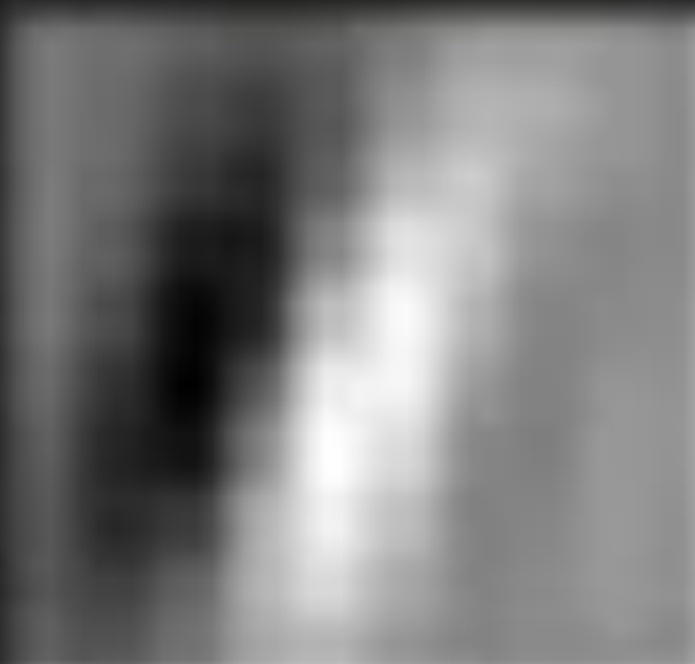
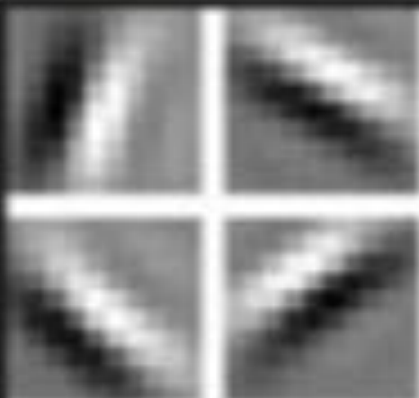
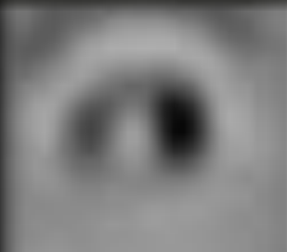
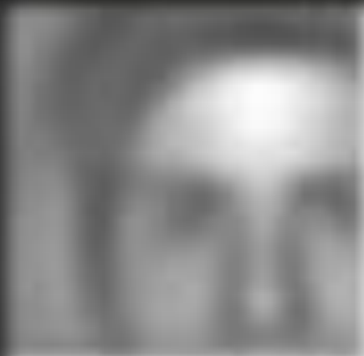
Toward Deep Learning Layers to represent features
Single pixel
Pixels
Lines
Shapes
Objects
Face
Notes:
\begin{bmatrix}
a_{1} & b_{1} \\
a_{2} & b_{2} \\
a_{3} & b_{3} \\
\hdotsfor{2} \\
a_{n} & b_{n}
\end{bmatrix}
\begin{bmatrix}
w_1 \\ w_2 \\
\end{bmatrix}
=
\begin{bmatrix}
y_{1} \\
y_{2} \\
y_{3} \\
\hdotsfor{1} \\
y_{n}
\end{bmatrix}

Slide 40
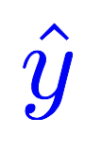
PHD Program Application
GPA (a) | Admission?
2.1 | 0
4.2 | 1
3.1 | 0
3.3 | 1
Linear
Sigmoid
x_data =[[2.1],
[4.2],
[3.1],
[3.3]]
y_data =[[0.0],
[1.0],
[0.0],
[1.0]]

Slide 41
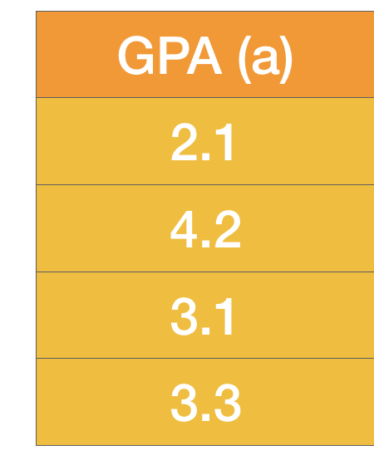
GPA enough?
How about experience and others?
Experience (b) | Admission?
0.1 | 0
0.8 | 1
0.9 | 0
0.2 | 1
Linear
Sigmoid
x_data =[[2.1, 0.1],
[4.2, 0.8],
[3.1, 0.9],
[3.3, 0.2]]
y_data =[[0.0],
[1.0],
[0.0],
[1.0]]

Slide 42
Matrix Multiplication
x_data =[[2.1, 0.1],
[4.2, 0.8],
[3.1, 0.9],
[3.3, 0.2]]
y_data =[[0.0],
[1.0],
[0.0],
[1.0]]
Linear
Sigmoid
Notes:
\begin{bmatrix}
a_{1} & b_{1} \\
a_{2} & b_{2} \\
a_{3} & b_{3} \\
\hdotsfor{2} \\
a_{n} & b_{n}
\end{bmatrix}
\begin{bmatrix}
w_1 \\ w_2 \\
\end{bmatrix}
=
\begin{bmatrix}
y_{1} \\
y_{2} \\
y_{3} \\
\hdotsfor{1} \\
y_{n}
\end{bmatrix}

Slide 43
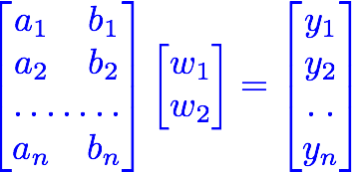
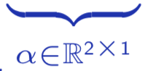
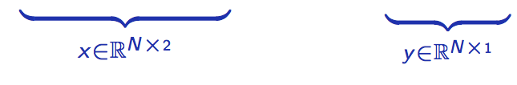
Matrix Multiplication
x_data =[[2.1, 0.1],
[4.2, 0.8],
[3.1, 0.9],
[3.3, 0.2]]
y_data =[[0.0],
[1.0],
[0.0],
[1.0]]
Linear
Sigmoid
Notes:
\begin{bmatrix}
a_{1} & b_{1} \\
a_{2} & b_{2} \\
a_{3} & b_{3} \\
\hdotsfor{2} \\
a_{n} & b_{n}
\end{bmatrix}
\begin{bmatrix}
w_1 \\ w_2 \\
\end{bmatrix}
=
\begin{bmatrix}
y_{1} \\
y_{2} \\
y_{3} \\
\hdotsfor{1} \\
y_{n}
\end{bmatrix}

Slide 44
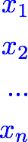

Matrix Multiplication
x_data =[[2.1, 0.1],
[4.2, 0.8],
[3.1, 0.9],
[3.3, 0.2]]
y_data =[[0.0],
[1.0],
[0.0],
[1.0]]
Linear
Sigmoid
Notes:
\begin{bmatrix}
a_{1} & b_{1} \\
a_{2} & b_{2} \\
a_{3} & b_{3} \\
\hdotsfor{2} \\
a_{n} & b_{n}
\end{bmatrix}
\begin{bmatrix}
w_1 \\ w_2 \\
\end{bmatrix}
=
\begin{bmatrix}
y_{1} \\
y_{2} \\
y_{3} \\
\hdotsfor{1} \\
y_{n}
\end{bmatrix}

Slide 45
Matrix Multiplication
x_data =[[2.1, 0.1],
[4.2, 0.8],
[3.1, 0.9],
[3.3, 0.2]]
y_data =[[0.0],
[1.0],
[0.0],
[1.0]]
Linear
Sigmoid
linear = torch.nn.Linear(2, 1)
y_prd = linear(x_data)
Notes:
\begin{bmatrix}
a_{1} & b_{1} \\
a_{2} & b_{2} \\
a_{3} & b_{3} \\
\hdotsfor{2} \\
a_{n} & b_{n}
\end{bmatrix}
\begin{bmatrix}
w_1 \\ w_2 \\
\end{bmatrix}
=
\begin{bmatrix}
y_{1} \\
y_{2} \\
y_{3} \\
\hdotsfor{1} \\
y_{n}
\end{bmatrix}

Slide 46
Go Wide!
Linear
Sigmoid
…
Linear
Sigmoid

Slide 47
Go Deep!
Linear
Sigmoid

Slide 48
Go Deep!
Linear
Sigmoid
Linear
Sigmoid
Linear
Sigmoid
…
sigmoid = torch.nn.Sigmoid()
l1 = torch.nn.Linear(2, 4)
l2 = torch.nn.Linear(4, 3)
l3 = torch.nn.Linear(3, 1)
out1 = sigmoid(l1(x_data))
out2 = sigmoid(l2(out1))
y_pred = sigmoid(l3(out2)

Slide 49

Sigmoid Activation Functions
Linear
Sigmoid

Slide 50
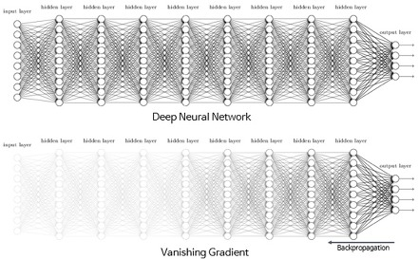
Sigmoid: Vanishing Gradient Problem
Linear
Sigmoid
http://excelsior-cjh.tistory.com/entry/RNN-LSTMLong-Short-Term-Memory-networks

Slide 51
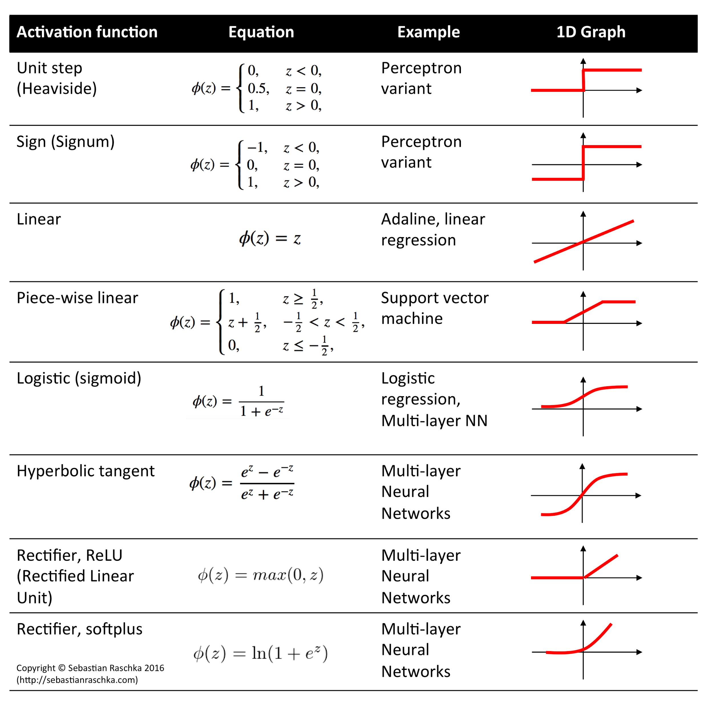
Activation Functions
Linear
Activation
http://rasbt.github.io/mlxtend/user_guide/general_concepts/activation-functions/

Slide 52

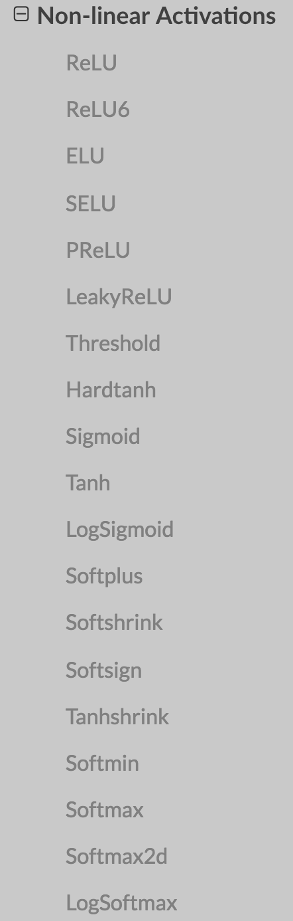
Activation Functions
Linear
Activation
http://rasbt.github.io/mlxtend/user_guide/general_concepts/activation-functions/

Slide 53
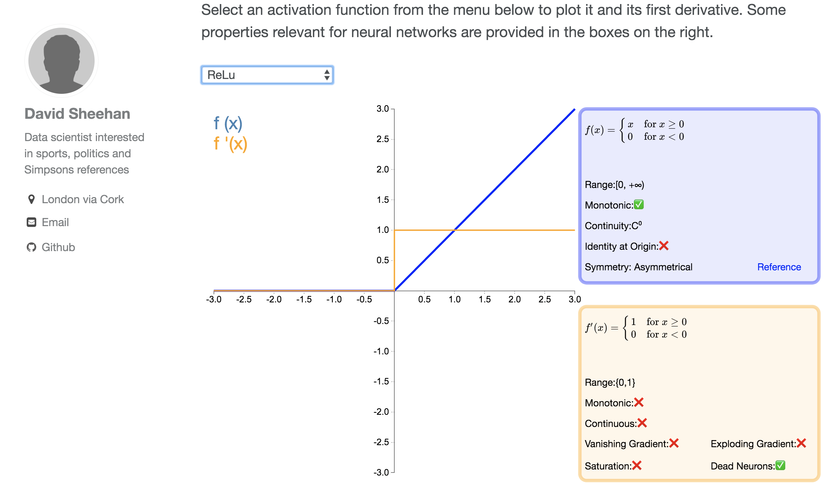
Many Activation Functions
https://dashee87.github.io/data%20science/deep%20learning/visualising-activation-functions-in-neural-networks/

Slide 54


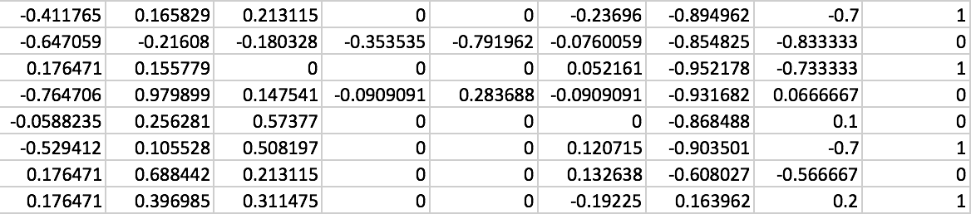
Classifying Diabetes
xy = np.loadtxt('data-diabetes.csv', delimiter=',', dtype=np.float32)
x_data = Variable(torch.from_numpy(xy[:, 0:-1]))
y_data = Variable(torch.from_numpy(xy[:, [-1]]))
print(x_data.data.shape) # torch.Size([759, 8])
print(y_data.data.shape) # torch.Size([759, 1])
Notes:
\hat{y}=x*w+b
loss = \frac{1}{N}\sum_{n=1}^{N} y^{(n)} \log \hat{y}^{(n)} + (1 - y^{(n)}) \log (1-\hat{y}^{(n})

Slide 55
Wide & Deep
class Model(torch.nn.Module):
def __init__(self):
"""
In the constructor we instantiate three nn.Linear module
"""
super(Model, self).__init__()
self.l1 = torch.nn.Linear(8, 6)
self.l2 = torch.nn.Linear(6, 4)
self.l3 = torch.nn.Linear(4, 1)
self.sigmoid = torch.nn.Sigmoid()
def forward(self, x):
"""
In the forward function we accept a Variable of input data and we must return
a Variable of output data. We can use Modules defined in the constructor as
well as arbitrary operators on Variables.
"""
out1 = self.sigmoid(self.l1(x))
out2 = self.sigmoid(self.l2(out1))
y_pred = self.sigmoid(self.l3(out2))
return y_pred
Notes:
\hat{y}=x*w+b
loss = \frac{1}{N}\sum_{n=1}^{N} y^{(n)} \log \hat{y}^{(n)} + (1 - y^{(n)}) \log (1-\hat{y}^{(n})

Slide 56



Classifying Diabetes
xy = np.loadtxt('data-diabetes.csv', delimiter=',', dtype=np.float32)
x_data = Variable(torch.from_numpy(xy[:, 0:-1]))
y_data = Variable(torch.from_numpy(xy[:, [-1]]))
class Model(torch.nn.Module):
def __init__(self):
"""
In the constructor we instantiate two nn.Linear module
"""
super(Model, self).__init__()
self.l1 = torch.nn.Linear(8, 6)
self.l2 = torch.nn.Linear(6, 4)
self.l3 = torch.nn.Linear(4, 1)
self.sigmoid = torch.nn.Sigmoid()
def forward(self, x):
"""
In the forward function we accept a Variable of input data and we must return
a Variable of output data. We can use Modules defined in the constructor as
well as arbitrary operators on Variables.
"""
out1 = self.sigmoid(self.l1(x))
out2 = self.sigmoid(self.l2(out1))
y_pred = self.sigmoid(self.l3(out2))
return y_pred
# our model
model = Model()
# Construct our loss function and an Optimizer. The call to model.parameters()
# in the SGD constructor will contain the learnable parameters of the two
# nn.Linear modules which are members of the model.
criterion = torch.nn.BCELoss(size_average=True)
optimizer = torch.optim.SGD(model.parameters(), lr=0.1)
# Training loop
for epoch in range(100):
# Forward pass: Compute predicted y by passing x to the model
y_pred = model(x_data)
# Compute and print loss
loss = criterion(y_pred, y_data)
print(epoch, loss.data[0])
# Zero gradients, perform a backward pass, and update the weights.
optimizer.zero_grad()
loss.backward()
optimizer.step()
Design your model using class
Construct loss and optimizer
(select from PyTorch API)
Training cycle
(forward, backward, update)
Notes:
\hat{y}=x*w+b
loss = \frac{1}{N}\sum_{n=1}^{N} y^{(n)} \log \hat{y}^{(n)} + (1 - y^{(n)}) \log (1-\hat{y}^{(n})

Slide 57
MNIST dataset size
60,000 training data images
10,000 test data images
28 x 28 grayscale image
With labeled
Very old-school format to download
Most of the frameworks include it
Notes:
\begin{bmatrix}
a_{1} & b_{1} \\
a_{2} & b_{2} \\
a_{3} & b_{3} \\
\hdotsfor{2} \\
a_{n} & b_{n}
\end{bmatrix}
\begin{bmatrix}
w_1 \\ w_2 \\
\end{bmatrix}
=
\begin{bmatrix}
y_{1} \\
y_{2} \\
y_{3} \\
\hdotsfor{1} \\
y_{n}
\end{bmatrix}

Slide 58
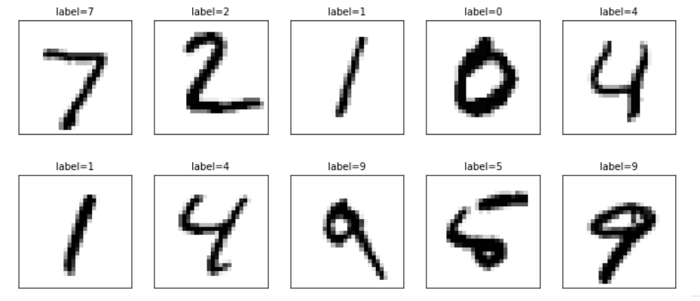
Hand-written digits Hello world of AI
Notes:
\begin{bmatrix}
a_{1} & b_{1} \\
a_{2} & b_{2} \\
a_{3} & b_{3} \\
\hdotsfor{2} \\
a_{n} & b_{n}
\end{bmatrix}
\begin{bmatrix}
w_1 \\ w_2 \\
\end{bmatrix}
=
\begin{bmatrix}
y_{1} \\
y_{2} \\
y_{3} \\
\hdotsfor{1} \\
y_{n}
\end{bmatrix}

Slide 59
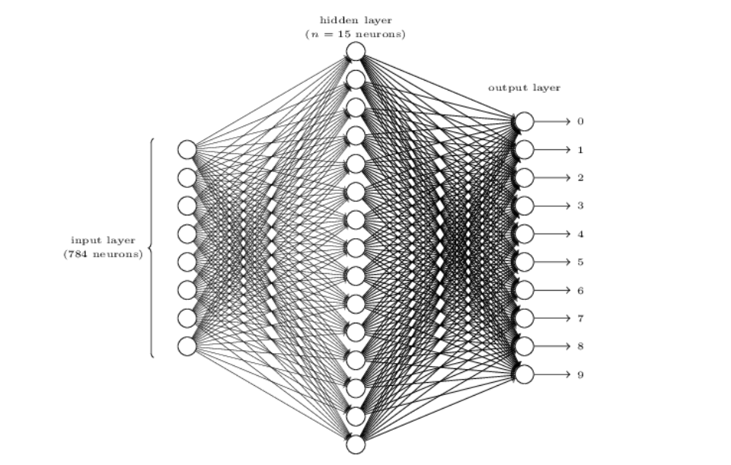
Flatten the 28 x 28 image to a 784 x 1 tensor
Notes:
\begin{bmatrix}
a_{1} & b_{1} \\
a_{2} & b_{2} \\
a_{3} & b_{3} \\
\hdotsfor{2} \\
a_{n} & b_{n}
\end{bmatrix}
\begin{bmatrix}
w_1 \\ w_2 \\
\end{bmatrix}
=
\begin{bmatrix}
y_{1} \\
y_{2} \\
y_{3} \\
\hdotsfor{1} \\
y_{n}
\end{bmatrix}

Slide 60
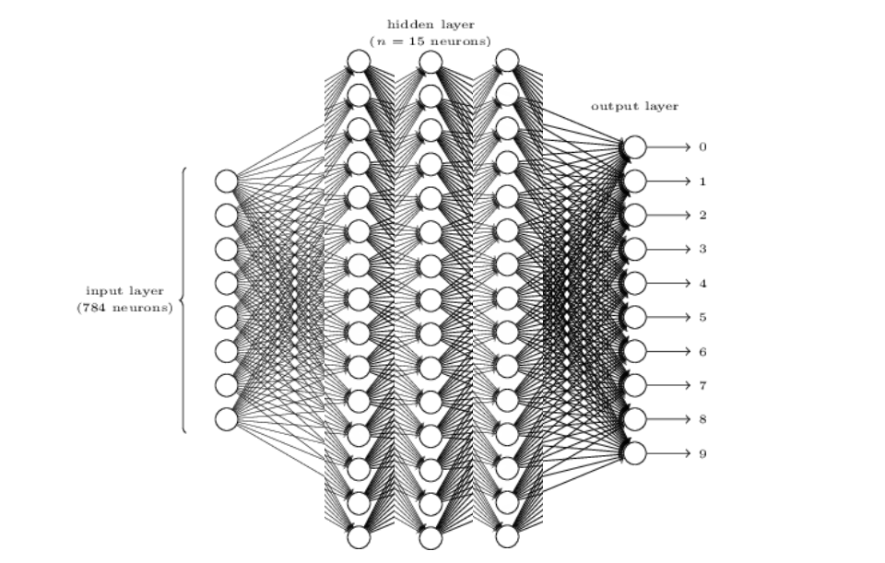
Could be more layers
Notes:
\begin{bmatrix}
a_{1} & b_{1} \\
a_{2} & b_{2} \\
a_{3} & b_{3} \\
\hdotsfor{2} \\
a_{n} & b_{n}
\end{bmatrix}
\begin{bmatrix}
w_1 \\ w_2 \\
\end{bmatrix}
=
\begin{bmatrix}
y_{1} \\
y_{2} \\
y_{3} \\
\hdotsfor{1} \\
y_{n}
\end{bmatrix}

Slide 61
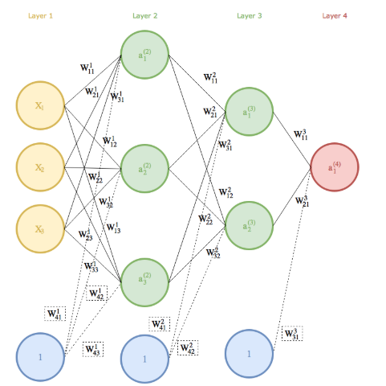
So many weights and biases
Notes:
\begin{bmatrix}
a_{1} & b_{1} \\
a_{2} & b_{2} \\
a_{3} & b_{3} \\
\hdotsfor{2} \\
a_{n} & b_{n}
\end{bmatrix}
\begin{bmatrix}
w_1 \\ w_2 \\
\end{bmatrix}
=
\begin{bmatrix}
y_{1} \\
y_{2} \\
y_{3} \\
\hdotsfor{1} \\
y_{n}
\end{bmatrix}

Slide 62
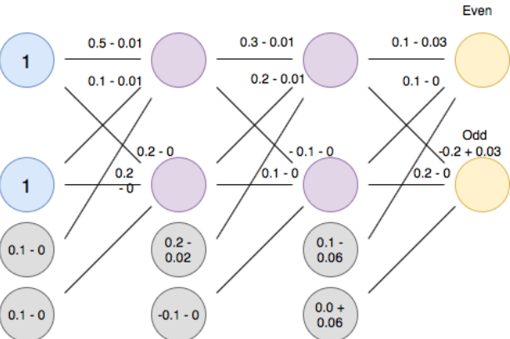
So many graidents to calculate
Notes:
\begin{bmatrix}
a_{1} & b_{1} \\
a_{2} & b_{2} \\
a_{3} & b_{3} \\
\hdotsfor{2} \\
a_{n} & b_{n}
\end{bmatrix}
\begin{bmatrix}
w_1 \\ w_2 \\
\end{bmatrix}
=
\begin{bmatrix}
y_{1} \\
y_{2} \\
y_{3} \\
\hdotsfor{1} \\
y_{n}
\end{bmatrix}

